Slide 1
Project 3 Web API’s & classification
General Assembly – DSI 9
Gabriel Perez Prieto

Slide 2


Agenda
Problem Statement
Data & EDA
Preprocessing
Methodology
Conclusion & Next Steps
Model Selection
Notes:
Problem Statement
Data & EDA
Preprocessing
Methodology
Model Selection
Conclusion & Next Steps

Slide 3

Problem Statement
Classify subreddit posts using NLP (Natural Language Processing)
Is it possible?
Why?
Accuracy of information on Reddit
Reliability of source
Understand behavior of users
Possibly create a campaign targeting specific groups of people
Notes:
Is it possible to accurately classify subreddit posts using NLP
2. Why?
Accuracy of information and reliability of reddit’s platform
Understand behavior of users
Is possible to target specific groups of people based on reddits?

Slide 4
Data & EDA
Data Collection – 10,000 subreddit comments
Data Cleaning:
Remove Duplicates
Remove Emojis
r/vegan – 4,836
9,664 Total Posts
r/vegetarian – 4,828
Notes:
1. 5,000 comments from subreddits vegan and vegetarian using the pushshift API on reddit
2. After data cleaning removing duplicates and emojis my dataset had about 9,600.

Slide 5
preprocessing
Tokenize
Regular Expression
Convert text into tokens
Feature Engineering
Number of words
Average length of words
Train / Test Split
Test Size = 25%
Notes:
Tokenized the text for each comment
With that I Created 2 more features to be included in the model – Number of words and average length of words in posts
Train test split 25% test

Slide 6
Modeling Methodology
Pipeline + Random Search
Column Transformer – Include Numerical Variables
Lemmatizer / Stemmer
Vectorizer – Count Vectorizer / Term Frequency Vectorizer
Classifier:
Logistic Regression
K-NN
Naive Bayes
Decision Tree
Random Forest
Support Vector
Notes:
Used a Pipeline + RandomSearch with:
Column Transformer to Include Numerical Variables
Created Classes in Python to Lemmatize and Stemm text inside of my pipeline function
Tested 2 vectorizers – Count and Term Frequency

Slide 7
Model selection – Logistic Reg
Accuracy!
71.3%
74.0%
Notes:
Baseline Model 50% = Red Line
All models have higher Accuracy than the Baseline model
Subreddits are very similar so results were expected to be low.

Slide 8
Model selection – random forest
Great predicting Vegans
95.0%
94.9%
Notes:
Really good model if Sensitivity is the scoring method used. TP / ( TP + FN )
Model was really good at predicting Positives (Vegan), but bad on Negatives (Vegetarian)
Only 71 out of 1201 observations were misclassified for Vegan Posts
pred_vegetarian pred_vegan
actual_vegetarian 394 817
actual_vegan 71 1130

Slide 9
Model selection – Decision Tree
Great predicting Vegetarians
91.4%
91.1%
Notes:
Really good model if Specificty is the scoring method used. (TN / (TN + FP)
Model was really good at predicting Negative (Vegetarian), but bad on Positives (Vegan)
Only 127 out of 1211 observations were misclassified for Vegetarian Posts
pred_vegetarian pred_vegan
actual_vegetarian 1084 127
actual_vegan 843 358

Slide 10
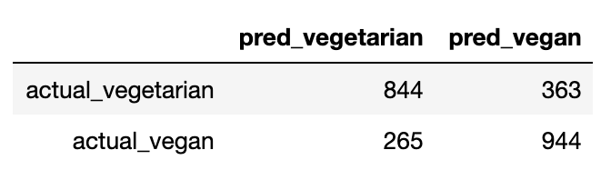
Model selection – Best Model (ACC)
Best Parameters:
Regularization: Ridge
Tokenizer: Stemmer
Stop Words: English
N_gram: (1,2)
Max Features: 2000
Confusion Matrix
Notes:
Model was selected based on:
1. Accuracy Score
2. Interpretability

Slide 11
Most Common Words
Notes:
1. A lot of repeating words for each subreddit, even with TF-IDF
2. It is very difficult to classify

Slide 12
Conclusion and Next Steps
Very challenging to differentiate / target selected groups!
Incorporate More Data
Different Subreddits
and / or
other sources
Understand better results for Decision Trees and Random Forests
Specificity and Sensitivity
Implement Sentiment Analysis
Develop set of Stop-Words for the model
Positive and Negative Comments
Notes:
1. It can be very challenging to differentiate / target selected groups such as Vegan and Vegetarian, especially if categories and repeating words are very similar
2. In case of a campaign trying to Target Vegans or Vegetarians, Reddit would not be enough to target accurately

Slide 13
Thank you !
Questions ?

